Slide 1
CS 31006: Computer Networks – Internet Routing

Slide 2
A Practice Problem
IP | Netmask | Next hop
128.96.170.0 | 255.255.254.0 | Eth0
128.96.168.0 | 255.255.254.0 | Eth1
128.96.166.0 | 255.255.254.0 | R2
128.96.164.0 | 255.255.252.0 | R3
0.0.0.0 | 0.0.0.0 | R4
What would be next hop for the following destination IPs?
128.96.171.92
128.96.167.151
128.96.163.151
Problem courtesy: Computer Networks, Larry L Peterson and Bruce S Davie

Slide 3
A Practice Problem
IP | Netmask | Next hop
128.96.170.0 | 255.255.254.0 | Eth0
128.96.168.0 | 255.255.254.0 | Eth1
128.96.166.0 | 255.255.254.0 | R2
128.96.164.0 | 255.255.252.0 | R3
0.0.0.0 | 0.0.0.0 | R4
What would be next hop for the following destination IPs?
128.96.171.92
-- 10101011
254 -- 11111110
Logical AND -- 10101010 -- 170
Destination is Eth0
Problem courtesy: Computer Networks, Larry L Peterson and Bruce S Davie

Slide 4
A Practice Problem
IP | Netmask | Next hop
128.96.170.0 | 255.255.254.0 | Eth0
128.96.168.0 | 255.255.254.0 | Eth1
128.96.166.0 | 255.255.254.0 | R2
128.96.164.0 | 255.255.252.0 | R3
0.0.0.0 | 0.0.0.0 | R4
What would be next hop for the following destination IPs?
128.96.167.151
167 -- 10100111
254 -- 11111110
Logical AND -- 10100110 -- 166
Problem courtesy: Computer Networks, Larry L Peterson and Bruce S Davie

Slide 5
A Practice Problem
IP | Netmask | Next hop
128.96.170.0 | 255.255.254.0 | Eth0
128.96.168.0 | 255.255.254.0 | Eth1
128.96.166.0 | 255.255.254.0 | R2
128.96.164.0 | 255.255.252.0 | R3
0.0.0.0 | 0.0.0.0 | R4
What would be next hop for the following destination IPs?
128.96.167.151
167 -- 10100111
252 -- 11111100
Logical AND -- 10100100 -- 164
Longest Match is 254. Next hop Eth1
Problem courtesy: Computer Networks, Larry L Peterson and Bruce S Davie

Slide 6
Routing in the Internet
Two different variants of routing protocols – (a) Intra-AS routing protocols, and (b) Inter-AS routing protocols
Intra-AS (Intra Domain) Routing Protocols: Routing within an AS; Example- Routing Information Protocol (RIP), Open Shortest Path First (OSPF). Sometimes, they are called as Interior Gateway Protocols (IGP)
Inter-AS (Inter Domain) Routing Protocols: Routing among the various ASes based on peering relationship; Example: Border Gateway Protocol (BGP). These are known as Exterior Gateway Protocols (EGP)

Slide 7
The Optimality Principle (Bellman 1957)
If Router J is on the optimal path from Router I to Router K, the the optimal path from J to K also falls among the same route.
I
J
K

Slide 8
Sink Tree
The set of optimal routes from all sources to a given destination form a tree rooted at the destination. Such a tree is called a sink tree.
Can you tell, why we are more focused to a destination centric tree, rather than a source centric tree?

Slide 9
Sink Tree
Sink tree for a destination may not be unique – there can be an alternate path between two routers with the same path length.
We may use a more generic data structure – a Directed Acyclic Graph (DAG), denoting all possible paths from all the source to a destination.
Both a tree or a DAG is okay – our objective here is to ensure loop-free routing

Slide 10
Distance Vector Routing
Operates by having each router maintain a table (i.e., a vector) giving the best known distance to each destination and which link to use to get there.
A distributed version of the Bellman-Ford Algorithm for Shortest Path.
Used in Routing Information Protocol (RIP) – the original ARPANET routing algorithm.

Slide 11
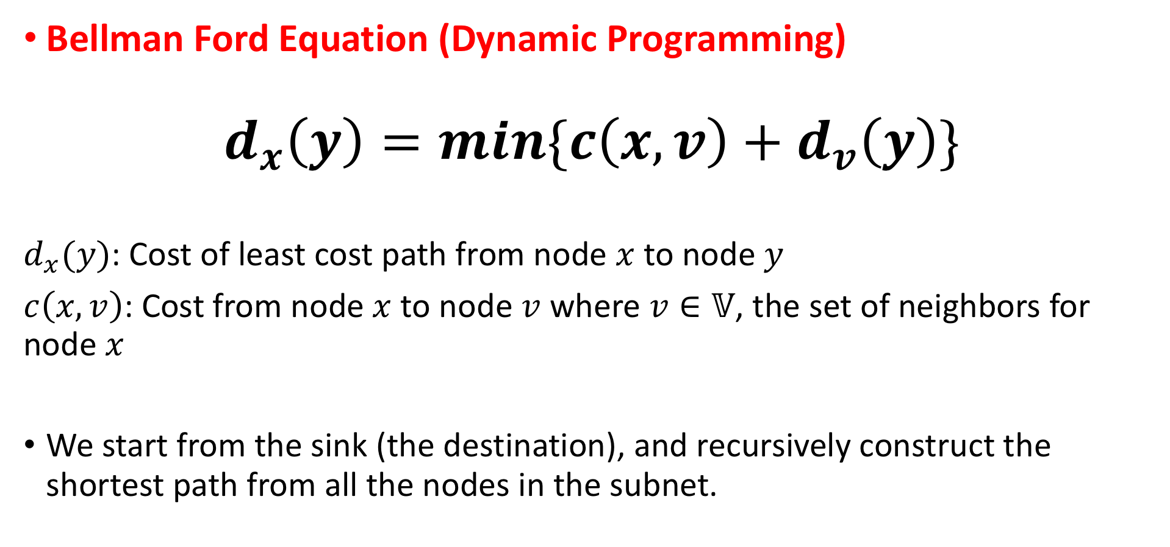
Distance Vector Routing
Bellman Ford Equation (Dynamic Programming)
$$d_{x}\left(y\right)=min\{c\left(x,v\right)+d_{v}\left(y\right)\}$$
$d_{x}(y)$: Cost of least cost path from node $x$ to node $y$
$c\left(x,v\right)$: Cost from node $x$ to node $v$ where $v∈𝕍$, the set of neighbors for node $x$
We start from the sink (the destination), and recursively construct the shortest path from all the nodes in the subnet.

Slide 12
Bellman Ford in Centralized Network
Initialize
S
8
20
S | A | B | C | D | E
0 | 8 | 20 | ∞ | ∞ | ∞
- | S | S | - | - | -
A
B
3
6
1
C
2
D
Iteration 1
1
2
S | A | B | C | D | E
0 | 8 | 20 | 14 | 21 | 22
- | S | S | A | B | B
E

Slide 13
Bellman Ford in Centralized Network
Iteration 1
S
8
20
S | A | B | C | D | E
0 | 8 | 20 | 14 | 21 | 22
- | S | S | A | B | B
A
B
3
6
1
C
D
Iteration 2
2
1
2
S | A | B | C | D | E
0 | 8 | 17 | 14 | 21 | 15
- | S | C | A | B | C
E

Slide 14
Bellman Ford in Centralized Network
Iteration 2
S
8
20
S | A | B | C | D | E
0 | 8 | 17 | 14 | 21 | 15
- | S | C | A | B | C
A
B
3
6
1
C
D
Iteration 3
2
1
2
S | A | B | C | D | E
0 | 8 | 17 | 14 | 17 | 15
- | S | C | A | E | C
E

Slide 15
Bellman Ford in Centralized Network
Iteration 3
S
8
20
S | A | B | C | D | E
0 | 8 | 17 | 14 | 17 | 15
- | S | C | A | E | C
A
B
3
6
1
C
D
Iteration 4
2
1
2
S | A | B | C | D | E
0 | 8 | 17 | 14 | 17 | 15
- | S | C | A | E | C
E

Slide 16
Distributed Bellman Ford To Distance Vector Routing
How do we move from one iteration to the next iteration for Bellman Ford algorithm?
We need the currently computed distance information from each node to others in the network – this is called the distance vector
Used to find out the routes between any two nodes
In RIP with CIDR, the routing table along with a metric field (denoting the cost) is used as the distance vector
S
8
20
A
B
3
6
1
C
2
D
1
2
E

Slide 17
Distributed Bellman Ford To Distance Vector Routing
S
A
S
S
00,-
08,A
20,B
23,B
21,B
15,A
08,S
00,-
9,C
6,C
9,C
7,C
00,-
08,A
17,A
14,A
17,A
15,A
S
8
20
A
B
A
3
6
1
B
C
2
D
C
1
2
E
D
E

Slide 18
Centralized Bellman Ford Versus Distance Vector Routing
Note the differences between centralized Bellman Ford algorithm and its distributed version used in distance vector routing.
We are destination oriented (path to sink) for both the variants
Centralized Bellman Ford: We find out the shortest path from all other nodes to the sink
Distance Vector Routing: We find out the shortest path from the current node to all other nodes that can work as the sink
Can you guess the reason for this?

Slide 19
Centralized Bellman Ford Versus Distance Vector Routing
Can you guess the reason for this? – Think of the convergence criteria
Centralized Bellman Ford: You know the number of iterations required. For n number of nodes, you need n-1 iterations.
Requires synchronous updates of distance tables
Distance Vector Routing: You do not know the number of iterations required, number of nodes (n) changes dynamically, distance vector updates are asynchronous
Update the local routing table asynchronously as and when you receive an update from a neighbor

Slide 20
The Count to Infinity Problem
Link A-B comes up
Link A-B gets down

Slide 21
Solving Count to Infinity
Split Horizon: Routing information is prevented from exiting the router on an interface through which the information was received.
A router needs to wait for a timeout to remove an entry from a routing table
Poisson Reverse: All known networks are advertised in each routing update. However, those networks learned through a specific interface are advertised as unreachable in the routing announcements sent out to that interface.
Routes are immediately removed when they are marked as unreachable from all the routing updates from all the neighbors.
However, the solutions adds up cost – increases the size of the route updates (you needs separate route broadcast at different interfaces) – We do not use these in practice

Slide 22
Limitations of Distance Vector Routing / RIP
The resolution to the counting to infinity problem enforces a maximum cost for a network path (generally 15 in RIP). This limits the diameter of a AS to a maximum of 15 hops.
High signaling overhead - Periodic broadcasting of the distance vector table can result in increased utilization of the network resources for signaling.
The algorithm is relatively slow to converge; you require information from all the nodes in the AS.

Slide 23
Link State Routing
1979: The ARPANET routing protocol was replaced by link state routing, as an impact to count-to-infinity problem (convergence become slow)
The routing protocol – Open Shortest Path First (OSPF)
The protocol is fairly simple
Discover neighbors and learn their network addresses
Set the distance or cost metric to each of the neighbors
Construct a packet telling all it has learned
Broadcast this packet – every router periodically learns the link state of the network graph
Compute the shortest path to every other routers

Slide 24
LSR - Learning about Routers
When a router is booted, it first learn the neighbors – broadcast a HELLO packet on each point to point line – note the use of broadcast IP address
Once a router receives a HELLO message, it sends back (this is an unicast IP packet) its identity (IP address)
H1
H2
H1
H2
H5
H4
H3
H3
H4
eth2
eth1
eth2
eth1
H5
R1-eth2
R1-eth1
R2-eth1
R2-eth2
R1
R2

Slide 25
LSR– Setting Link Costs
Each link is assigned with a link cost or distance (hop count, delay) which is used as the routing metric to find out the shortest path
A standard approach – inverse of the link bandwidth - higher capacity paths are better choices (minimize the routing cost)
Some networks use link delay - computed through a ICMP ECHO packet from the IP layer
ICMP – Internet Control Message Protocol – a set of message suites for IP layer management functionalities
ICMP Echo Request and ICMP Echo Reply

Slide 26
LSR – Building Link State Packets
Image: Computer Networks, Andrew S. Tanenbaum, David J. Wetherall

Slide 27
LSR – Distributing the Link State Packets
All of the routers must get all of the link state packets quickly and reliably
If different routers have different information, the routing inconsistency may occur
Use flooding to distribute the link state packets to all the routers.
Each Link state packet contains a sequence number that is incremented for each new packet sent – used to identify stale information
Image: http://www.danzig.jct.ac.il/tcp-ip-lab/ibm-tutorial/3376c33.html

Slide 28
LSR – Distributing the Link State Packets
Image: http://cnp3book.info.ucl.ac.be/1st/html/network/network.html

Slide 29
LSR – Distributing the Link State Packets
Once a Link State (LS) packet is received, the sequence number is checked
If the sequence number is higher than the last observed LS packet, then it is accepted; otherwise it is discarded
What if the sequence number wraps around?
Use a 32 bit sequence number, and 1 LS packet per second – it would take 137 years to wrap around
Every entry in the router is associated with an age – denotes the lifetime of an entry
Deletes the old entries from the routing table

Slide 30
LSR – Computing the New Routes
Construct the network graph from the link state packets
Image: http://cnp3book.info.ucl.ac.be/1st/html/network/network.html

Slide 31
Link State Routing - OSPF
Link State Messages – Overhead for the LSR
OSPF Messages
HELLO: Used to establish neighborhood
Database Descriptor (DD or DBD): Broadcast the local routing database among neighbors – check consistency of database information among routers
Link State Requests (LSR): Explicitly requests for link state information based on the database comparison
Link State Updates (LSU): Forward link state information
Link State Acknowledgements (LSAck): Acknowledges the receipt of link state information

Slide 32
Inter-domain Routing Protocols
Routing between two autonomous systems (AS) – we call them as routing domains
Exterior Gateway Protocol (EGP)
Multi-homed AS: has connection to more than one AS
Stub AS: Connected to only one other AS
Transit AS: Provides connection to other AS
Photo courtesy: http://www.web3.lu/

Slide 33
Routing Protocols inside and across AS
Each AS can run its own intra-domain routing protocols, we call them as interior gateway protocols (IGP)
Open Shortest Path First (OSPF)
Routing Information Protocol (RIP)
Can even use static routing or a mixed of IGPs at different subnets
Inter-domain routing problem – the AS shares reachability information – description of the set of IP addresses that can be reached via a given AS
Challenge – Each AS has to determine its own routing policies (can be complex)
Whenever possible, I prefer to send traffic via AS X than via AS Y, but I’ll use AS Y if it is the only path; and I never want to carry traffic from AS X to AS Y or vice versa.

Slide 34
Routing Policies in the Internet
AS X
AS Y
AS Z
Primary Traffic
Secondary Traffic
Transit Traffic

Slide 35
Border Gateway Protocol (BGP)
The initial protocol (called EGP) was designed for specialized topology, such as a tree topology.
BGP replaces EGP – generalizes the topology structure of the Internet.
BGP assumes that the Internet is an arbitrary interconnected set of ASs.
Local Traffic: Originates at or terminates on nodes within an AS
Transit Traffic: Traffic that passes through an AS

Slide 36
Traffic through an AS
Stub AS: Only carry local traffic
Multi-homed AS: Only carry local traffic, refuses to carry transit traffic
Transit AS: Carry both transit and local traffic

Slide 37
Objectives of BGP
Best non-looping policy-complaint path
Loop free path through the ASs
Complaint with the policies of the various ASs along the path
Scaling – CIDR at the Internet scale may not be scalable – You need to store IP/netmask information for thousands of subnets
Define paths by AS numbers, not the IP; Example AS12-AS14-AS76-AS132-AS45-AS61
Path Cost – the autonomous systems are “autonomous” – every AS has their own interior routing protocol and own routing metrics – how to define a path metric for a BGP path?
Advertise only the reachability information, no path costs are associated with

Slide 38
Network Layer Reachability Information (NLRI)
AS Reachability information shared by the BGP supported routers (called the BGP peers)
Shared between BGP peers through BGP UPDATE messages
An IPv4 prefix (with IPv4 protocol) with the corresponding network IP
Example: 110.12, /16
Used to find out the AS reachability as well as route aggregation through CIDR
Combine 110.12/16 and 110.12.8/24 together to form 110.12/16 – You do not need to maintain duplicate paths

Slide 39
BGP Speakers and BGP Peers
BGP Speakers – A router configured with BGP – a spoke-person for the entire AS
Advertises the reachability information for this AS
Once initialized, uses the well known BGP port (TCP port 179) to connect to other configured BGP peers in the Internet, and share the AS reachability information
BGP speakers advertised the path information with the BGP speakers in the peer ASs.

Slide 40
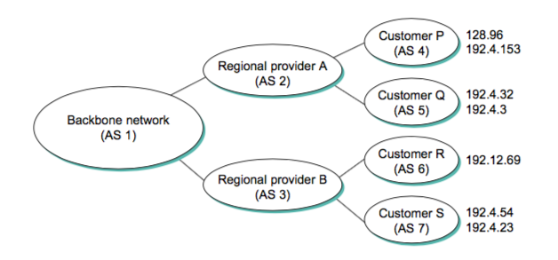
BGP Path Information
BGP advertises complete path information as enumerated list of ASs to reach a particular network
Necessary to enable the sorts of policy decisions
Enables routing loops to be readily detected
AS 2 can advertise NLRI for the subnets given to Customer P and Customer Q
AS 3 can reach to the subnet 128.96 via the AS Path AS3-AS1-AS2-AS4
Image courtesy: Computer Networks, Larry L Peterson and Bruce S Davie

Slide 41
BGP AS_PATH Attribute in UPDATE Message
Stores all the paths across various ASs through which a BGP UPDATE message has passed
Every BGP speaker, when receives an UPDATE message, appends its own AS number and advertise that to the BGP peers

Slide 42
BGP UPDATE Message Propagation
110.23/16
AS 51
AS 59
AS 10
111.25/16
AS 138
AS_PATH | 10
NLRI | 110.23/16
NLRI | 111.25/16
AS 228
AS 782

Slide 43
BGP UPDATE Message Propagation
110.23/16
AS 51
AS 59
AS 10
111.25/16
AS_PATH | 10 51
NLRI | 110.23/16
NLRI | 111.25/16
AS 138
AS 228
AS 782

Slide 44
BGP UPDATE Message Propagation
110.23/16
AS 51
AS 59
AS 10
111.25/16
AS_PATH | 10 51 59
NLRI | 110.23/16
NLRI | 111.25/16
AS 138
AS 228
AS 782

Slide 45
BGP UPDATE Message Propagation
110.23/16
AS 51
AS 59
AS 10
111.25/16
AS 138
AS 228
AS_PATH | 10 51 59 138
NLRI | 110.23/16
NLRI | 111.25/16
AS 782

Slide 46
BGP UPDATE Message Propagation
110.23/16
AS 51
AS 59
AS 10
111.25/16
AS 138
AS 228
AS 782
AS_PATH | 10 51 59 138 228
NLRI | 110.23/16
NLRI | 111.25/16

Slide 47
BGP UPDATE Message Propagation
110.23/16
AS 51
AS 59
AS 10
111.25/16
AS 138
AS_PATH | 10 51 59 138 228 782
NLRI | 110.23/16
NLRI | 111.25/16
AS 228
AS 782

Slide 48
BGP Route Establishment
Based on the BGP UPDATE message, a BGP speaker may have multiple paths to a subnet
The BGP speaker chooses the best one according to its own local policies -> It advertises this route in the next BGP UPDATE message
Check the set of rules that are followed for BGP path establishment algorithm: https://www.cisco.com/c/en/us/support/docs/ip/border-gateway-protocol-bgp/13753-25.html
Image courtesy: https://www.cisco.com

Slide 49
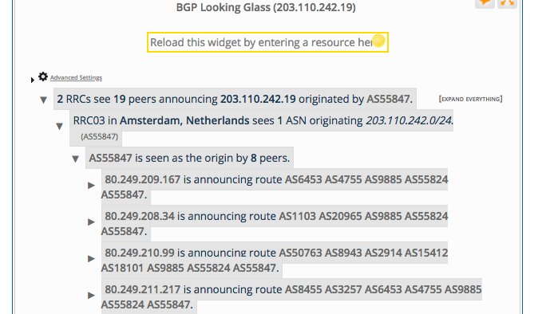
BGP Looking Glass
https://stat.ripe.net/widget/looking-glass

